Slide 1
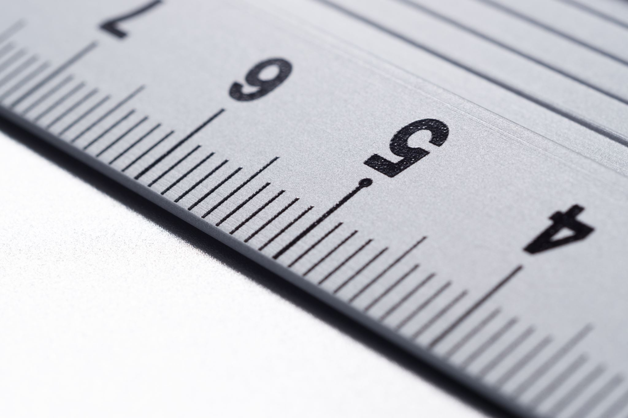

Radius, Diameter, Circumference and PI(π)
Click on the sound icon:
7/26/19
By Kush Patel

Slide 2
What Will be learning about today.
Click the Sound Icon to hear the lesson:
Today we will be learning all about the following properties of a circle
Radius
Diameter
Circumference
PI (π)

Slide 3
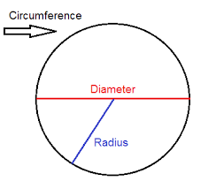
Radius
Click on the Sound Icon to hear about the lesson:
The Radius of a circle is a line that connects from the center of the circle to the circumferences/edge of the circle.
The Formula to find the Radius r=d/2.
8 in
d=diameter
r=radius
d=8 inches
r=8/2
r=4 inches
4 in

Slide 4
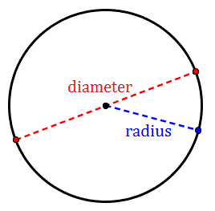
Diameter
Click on the Sound Icon to learn about the lesson:
The Diameter is a straight line passing from the center of the circle and endpoint lies on the circle
The formula to find diameter is d= 2r
10 inches
D=Diameter
r=Radius
r=5 inches
d=2(5)
d=10 inches
5 inches

Slide 5
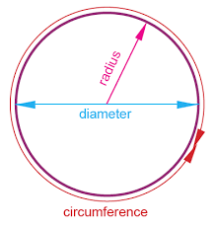
Circumference
Click on the Sound Icon to hear more about the lesson:
The Circumference is the distance around the circle. The formula to find the circumference is c=2πr
3 in
r=Radius
c=circumference
Π=3.14
r=3 in
c=2(3)(π)
C=6π
6π=18.84
C=18.84 in
6 in
18.84 in

Slide 6
PI
Click on the Sound Icon to hear more about the lesson:
Pi(π) is a mathematical constant, it is a ratio of a circumference to its diameter
Formula: π = C/d
Pi(π) is also the 16th letter of the Greek alphabet
The approximation number of pi is 3.14
Fractions such as 22/7 is an approximation for π
Pi(π) is used a lot in circles, spheres, cones, cylinders or any shape/figure having a circle as a face or base, finding the diameter, radius, circumferences or area of a circle
π(pi) is a never-ending number it goes on and on and there is no end digit 3.1415926535 8979323846 2643383279...

Slide 7
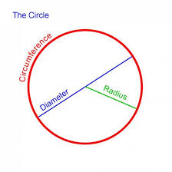
Example Problem 1
Click the Speaker Icon to hear the lesson
In this problem we will find the circumference of this circle:
In this problem only the diameter is given so we will use the formula C=πd. C is the Circumference; d is the diameter and π is 3.14.
8 inches
We will multiply the diameter by 3.14
The diameter is 8 inches
8*3.14=25.12
The Circumference is 25.12 inches

Slide 8
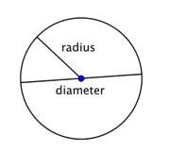
Example Problem 2
In this problem we will find the circumference of this circle:
3 inches
In this Problem only the Radius is given so we will use the formula C=2πr. C is the Circumference, r is the Radius and π is 3.14
We will multiply the radius by 3.14 and the n multiply it by 2
2*3.14=6.28
6.28* 3=18.84
18.84 inches is the circumference

